Slide 1
Multi-sector support to the displaced in Adamawa and Borno States

Slide 2
Background
  Dec. 1, 2016 – Feb. 28, 2019
  Sectors: Livelihoods, Nutrition, WASH
  Objectives:
    IDPs, host communities, and returnees in Nigeria access basic needs and improved livelihood opportunities
    IDPs, host communities and returnees in Nigeria have access to improved WASH and health services
  Locations: Mubi North and South, Michika and Maiha, MMC/Jere and Askira Uba

Slide 3
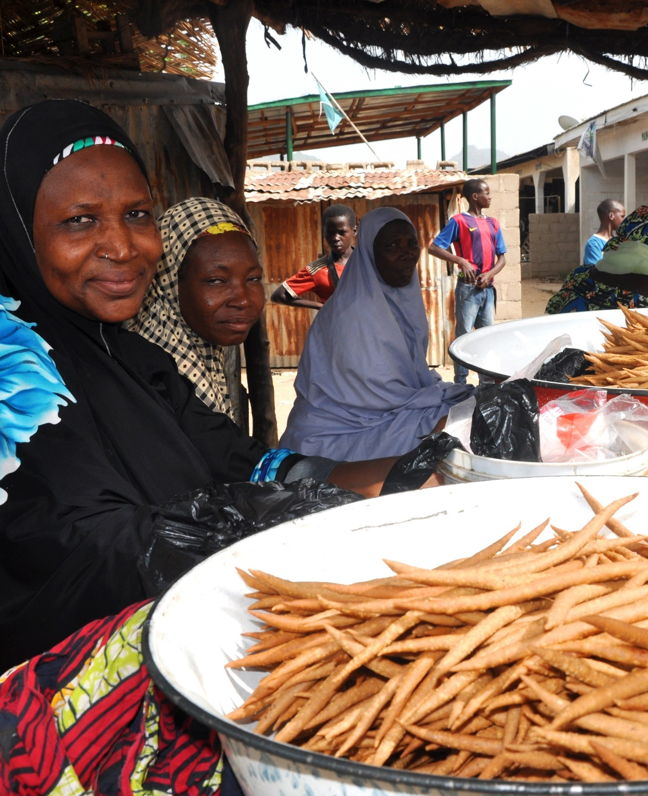
Livelihoods
by the numbers
3,200 households
received 4 rounds of UCT
800 persons
engaged via 81 cash-for-work schemes
$22,100 USD +
in pooled VSLA savings (YR1 only)
1,000 farmers
trained and provided material support
Notes:
Photo Caption: Fadimatu Abubakar, a 50 year old indigene of Moda Community in Michika Local Government Area and IRC beneficiary, sells groundnut cake and grains in Michika Market.
UCT = Unconditional Cash Transfer

Slide 4
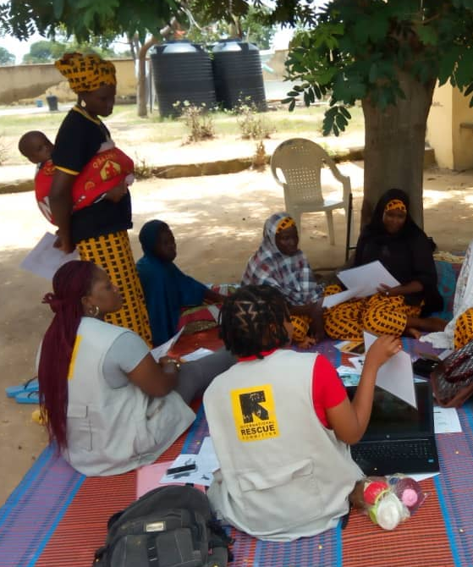
Nutrition
by the numbers
17,399 children with SAM
discharged as cured
Nutrition
51,687 mothers
provided group or individual counselling by MTMSGs
4,782 caretakers
attending cooking demonstrations
21,388 men
reached with critical child nutrition messages
Notes:
Photo Caption: An IRC Nutrition Officer leads a group counselling session for mother-to-mother support group members in Wambilimi community, Adamawa.

Slide 5
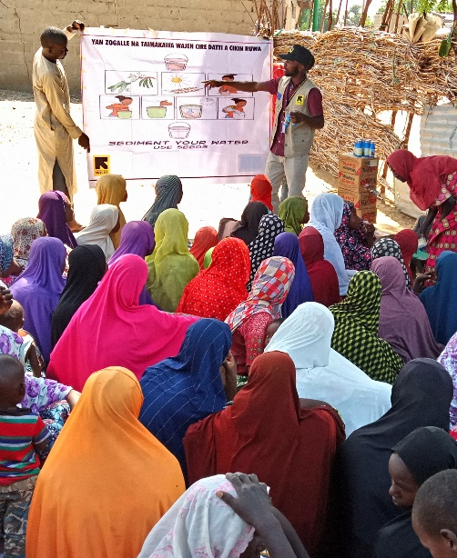
WASH
by the numbers
5,801 households
received hygiene kits (NFIs)
59,798 persons
benefiting from improved water supply
100% of facilities
using soap or ash handwashing
109,202 persons
receiving key hygiene messages
Notes:
Photo Caption: Sensitization (Hygiene Promotion) prior to Distribution of Water Treatment Chemical at Wadiya community of Jere LGA Borno State.

Slide 6
Lessons Learned
  Project implementation in Adamawa (Mubi Axis) and MMC/Jere benefited from relative stability despite proximity to emergency context
  Government/community stakeholders in an emergency/ protracted crisis conflict can become over-reliant on humanitarian actors to provide critical assistance (i.e. expectation of INGO response to cholera in Fufore LGA, Adamawa State)
    Be careful that humanitarian imperative to provide respond does not result in reduced local ownership and resilience
    Projects that support stakeholders to better prepare for and respond to shocks (natural disaster, conflict, etc.) would be beneficial

Slide 7
Lessons Learned cont.
  Inadequate government support for local ministries (possibly due to diversion of resources to geographies of heightened conflict) leads to high turnover of staff, resulting in need for regular training and re-training of gov. agencies/partner institution staff
  Integration of programming in humanitarian response has proved challenging due to various donor and implementing partner priorities which is then reflected by local stakeholders working in silos
    Separating sectors (i.e. primary health, WASH, etc.) can be highly effective in responding to acute emergency needs, but is not sustainable in longer-term development

Slide 8
Livelihoods Strategies
Farmer Field School
VSLA start-up and support
Business, financial management and life skills training
Business start-up grants and business plan review
Strategies are adapted to the unique context of Mubi Axis (Mubi North, Mubi South, Askira Uba), including:
Inaccessibility of formal marketplaces
Destruction/ closing of formal banking institutions
Notes:
For context pt. 1 – Note that most farmers or people involved in crafting/trading can’t access major market places so prices are highly subject to local supply and can vary highly. For example, if all farmers in a community are trying to sell the same crops at the same time of year, prices are very low and not sufficient for livelihoods to be sustained. To combat this, the IRC provided Farmer Field School participants with training and supplies for longer crop storage (including PICS crop storage bags). This has the added benefit of crops being available throughout the year which has secondary nutrition benefits
Context pt. 2 is addressed through creating self-reliant VSLAs. All indications at this point show that the individual groups will continue meeting on their own. They haven’t received any additional IRC input in the past few months, but continue to meet regularly.

Slide 9
Livelihoods Strategies cont.
Economic development as livelihoods, not “job creation”
  Many individuals, especially farmers, pursue a variety of livelihood activities at different times of the year
Obtaining and maintaining buy-in from community leadership and creating community accountability mechanisms is essential to the sustainability of non-formal livelihood schemes, for example:
  The Chairman of Michika LGA became a very strong partner in the promotion of CFW schemes and made a commitment to IRC and community members to continue such schemes in the future
  Joint meetings were held between the IRC, CFW beneficiaries, local CFW committees and community leaders to finalize sustainability plans
Notes:
Cash-for-work is not traditionally not the most sustainable interventions; however high-level buy in and community organization has changed that

Slide 10
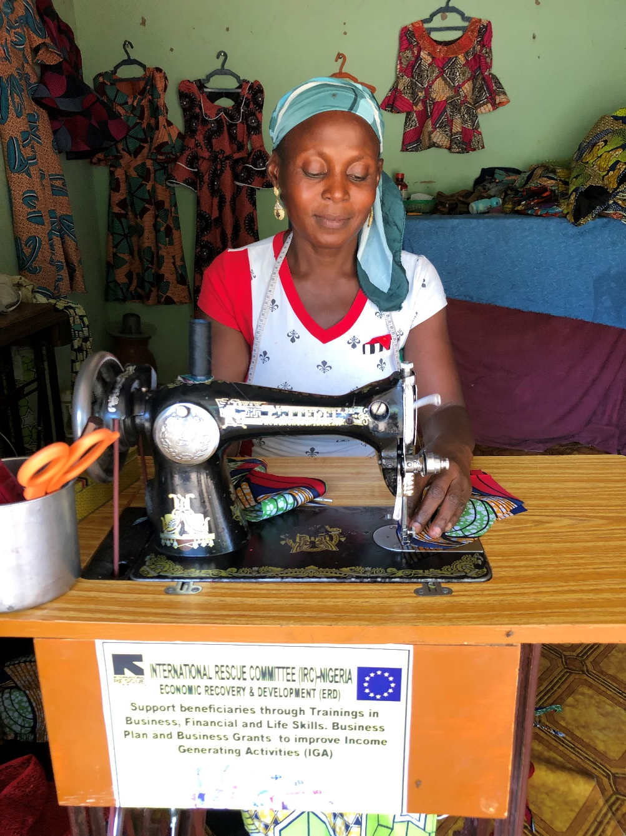
Notes:
Margaret, a 31 year-old mother of four from Jigalimbu community of Michika LGA of Adamawa state has been involved in tailoring business before the conflict. However, she was forced to flee her community when the insurgent attacked their community. Margaret lost everything. Hope was restored to her when the IRC came to her community with the support of the EUTF funding. She was registered as an Income Generating Activities (IGA) beneficiary on the project. She received training on financial and business skills for three months, on completion of the training she developed a business plan and a secured cash grant from IRC worth NGN65,000 (EUR 150) to grow her business. Margaret has her own tailoring machine, generator and other tools from the cash grant she received, and is able to fully support her family. When I met her in December, her business was thriving and all of the clothes behind her were orders she was fulfilling.

