Slide 1

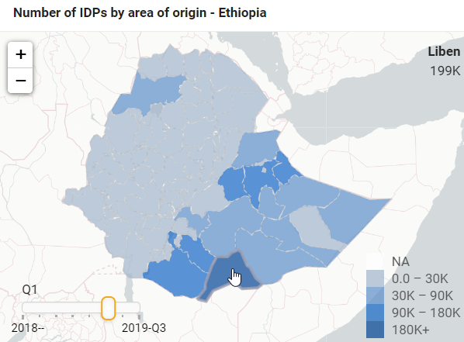
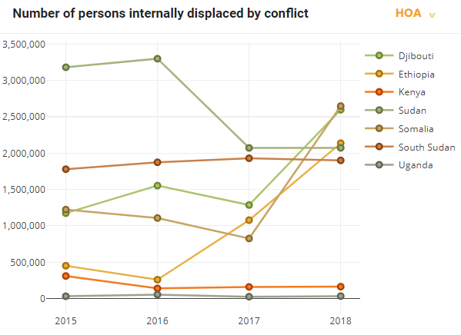
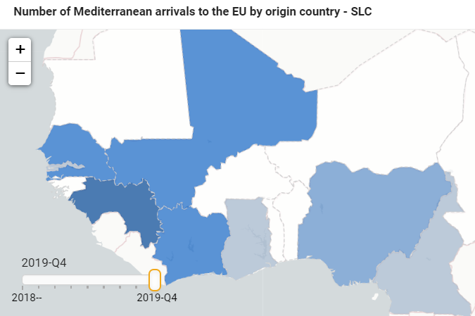
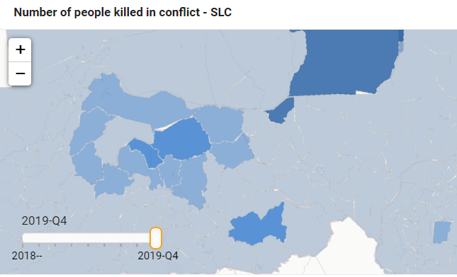
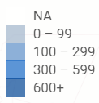
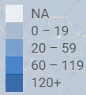
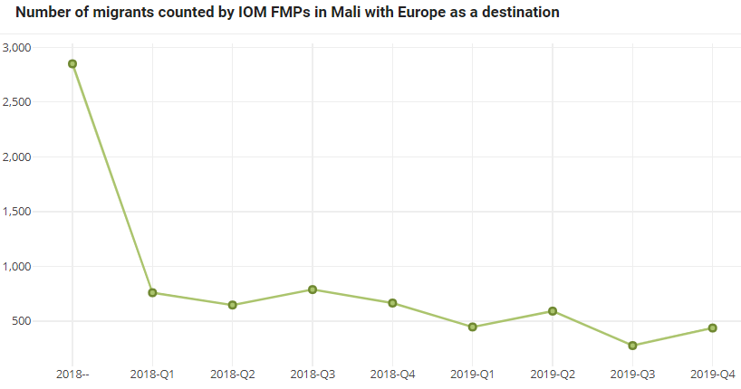
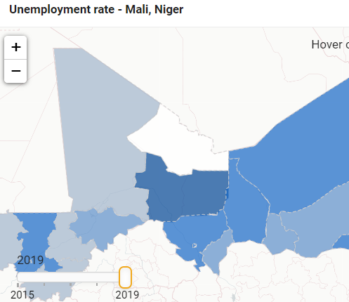
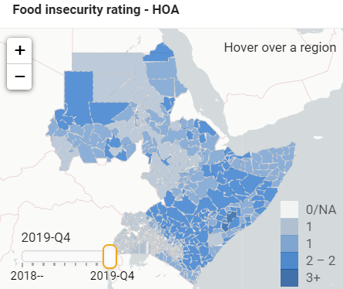
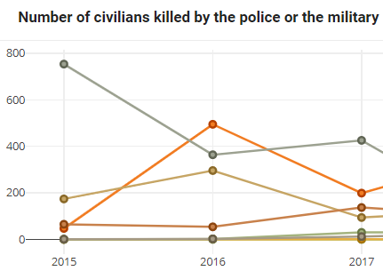
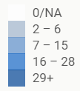



EU Emergency Trust Fund for Africa - Monitoring and Learning System: High-level indicators
October 2020
What are high-level indicators?
The EUTF Monitoring and Learning System (MLS) already aggregates and analyses data collected by implementing partners on the outputs they produce in their intervention areas
High-level indicators use external sources of data in order to complement EUTF partners’ data
Coverage
High-level indicators data was collected for 2015-19, in two windows (Sahel - Lake Chad and Horn of Africa), using sources including IOM DTM, ACLED, FEWS NET, satellite data and household surveys
The following themes are covered:
EUTF overall objectives
High-level indicators data can help answer questions such as…
What are the areas that are most in need of interventions?
Addressing the root causes of…
Forced displacement
Irregular migration
Instability
How have issues targeted by the EUTF evolved at the country, regional and continental level?
Irregular migration to Europe on a sharp decline
EUTF strategic objectives
Economic opportunities
Resilience
Governance
How does the presence of EUTF actions correlate* with trends on the ground?
In Ethiopia, over time, less people are internally displaced from districts where EUTF-funded projects are implemented
Potential contributions will most likely require a longer time- and geographical frame, as well as additional data collected by key partners, to be detected or validated
(Current analyses cover only four pilot countries, with data up until 2019)
In all pilot countries, the presence of EUTF-funded projects is correlated with a slight reduction in the impact of droughts on food insecurity
…and more
Going forward
*The MLS used statistical analyses (regressions with controls, propensity scores matching, fixed effects estimations) that can only hint at possible contributions, but it should be noted that similar techniques have been used as part of the impact evaluations of major donors’ development programmes (e.g. EU Joint Research Centre on the SAPARD programme, USAID on the MISTI programme)
Data whose extraction can be automatised will be continuously updated on the MLS dashboard, and their correlations with EUTF programming will be re-analysed periodically.
Future EU programming could integrate a tracking and analysis tool that could be similar in spirit to the high-level indicators pilot system. The full potential of such a tool would be unlocked by building strong partnerships with, and in some case providing support for, external organisations collecting relevant data.
Beyond such analyses, why the need to centralise this external data, as most of it is publicly available?
A large part of the data is only available in technical formats sometimes unusable as such by EUTF managers and the wider public, and no central repository exists.
All data can be explored on maps and downloaded in excel.
For additional information on the MLS, please access the EUTF monitoring page or contact Eric Davin, team leader
edavin@altaiconsulting.com

