Slide 1
Welcome

Slide 2
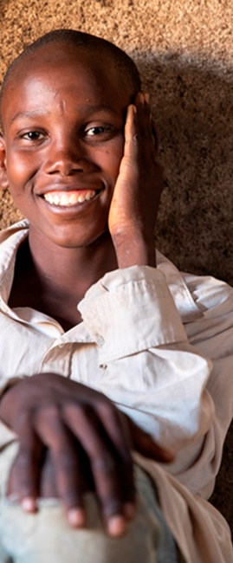
I-SING
Investing in the Safety and Integrity of Nigerian Girls &Boys
Program Overview
HUGH BRIGGS
PROGRAM MANAGER

Slide 3
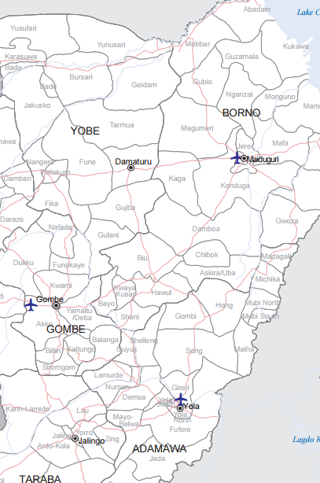
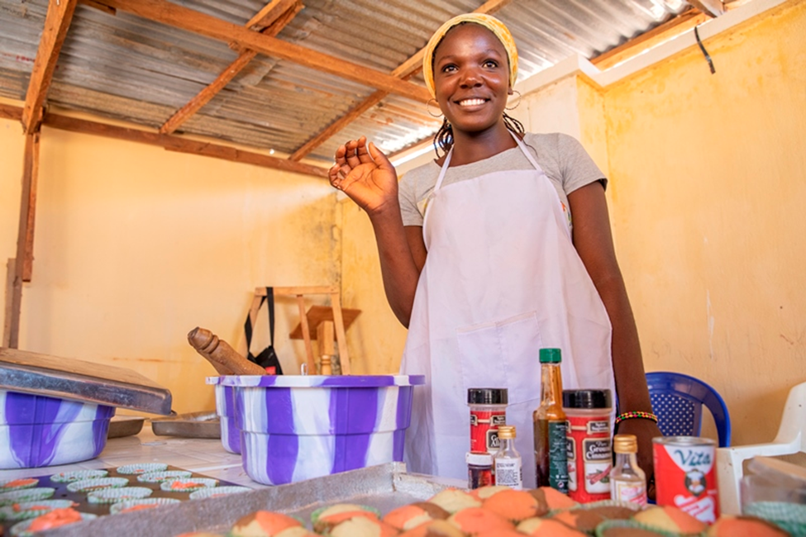
I-SING
Major Activities
Enrolment of 17000 beneficiaries into Safe spaces
Recruitment and training of 984 mentors and coordinators
Development of a health and life skills and financial education curriculum for boys and girls
Training of more than 961 community members on protection
Livelihood interventions-considered safe and acceptable for 5,100 older adolescent's-grants

Slide 4
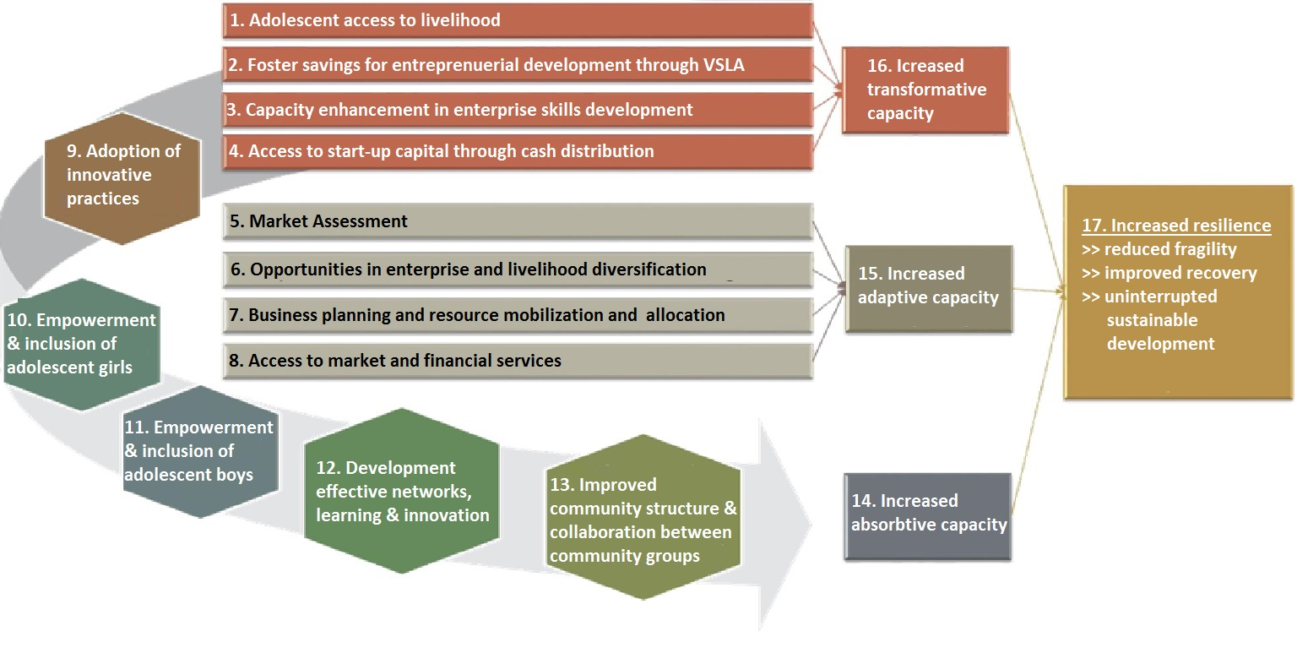
Our Resilience Approach

Slide 5
What we Achieved
Set up safe spaces to build self-confidence, self-esteem and make friends: the process has strengthen the resilience capacity of adolescents in facing life challenges and positive contributors in their respective communities = 16,947 successfully completed safe spaces
The program has created jobs for 984 mentors and coordinators + increase the number of skilled personnel in 31 communities
Set up 247 VSLAs for adolescent’s to access credit and to broaden their circle of friendship

Slide 6
What we Achieved
Capacities of adolescents built in enterprise skills, to develop viable business plans Provided means of livelihood through distribution of grants to 4,923 adolescents
Distribution of cash grants to 4,923 adolescents: Establishment of micro and small enterprises for adolescents through access to finance, Business Development Support, trainings and market access
Linked 2,800 (+ additional 56 in MDG) adolescents to local skill artisans/centers 90% completion rate: only 38 did not complete learning. Adolescents were linked to the local market through local market fares and the just concluded ISING Summit

Slide 7
What we Achieved : VSLA Share - Out
Share Value Summary Across Program Locations: Share Price Between NGN 20 to 100
Location | Share Value | Lowest Share Received | Average Share Received | Highest Share Received | Average Return on Investment
South Borno | 2,094,642 NGN (5,211 EUR) | 300 NGN (0.74 EUR) | 2,650 NGN (7 EUR) | 12,350 NGN ( 31 EUR) | 750 NGN
Gombe | 2,731923 NGN (6,796 EUR) | 540 NGN ( 1.34 EUR) | 2,750 NGN ( 9 Euros) | 13,580 NGN ( 34 EUR) | 800 NGN
Maiduguri | 815,480 NGN (2,029 EUR) | 100 NGN ( 0.24 EUR) | 1,100 NGN ( 3 EUR) | 2,100 NGN ( 5 EUR) | 500 NGN
TOTAL | 5,637,145 NGN (14,023 EUR)

Slide 8
CHALLENGES
Community fears-Chibok
Culture and religion
Perceptions related to relief vs skills building
Security
Identification of Safe spaces
Some community leaders asking for incentives

Slide 9
KEY LESSONS LEARNT
Working with local artisans reduces protection risks in the community by providing skilled labor closer to the adolescent girls
The safe spaces approach for the adolescent’s was a fun and learning experience that enabled adolescent’s to learn, giving the adolescents opportunity to participate in the program improves their self-confidence, which in turn allows them to articulate their needs better in the community, integrate and support each other in the community
The phased approach helped us replicate better programming across the project locations
Working with Mentors, coordinators, community advisory committees encouraged acceptance and remain key resources persons in the community having been trained on various topics by program staff

Slide 10
KEY LESSONS LEARNT
Collaboration with other agencies ensures access to services for adolescent’s e.g. working closely with the Ministry of Women affairs in Gombe enabled the program link adolescent’s to access birth registration documents
Engaging adolescents in safe spaces before livelihood interventions improves better outcomes for them.
Safe spaces + grant disbursement to start businesses + skill building = Autonomy. We know safe spaces alone are not enough
Developing a strategy for cash disbursement and including guardians for the adolescent’s reduces the risk of fraud and other protection issues
Accountability between the community and program staff is key for the successful implementation of the project. Creating and enabling avenues for the community to report any mal practice ensures transparency and trust

Slide 11
Conclusion about Early Recovery in ongoing conflict and protracted crisis
Strengthening Government and systems to be more responsive and coordinated in the delivery of services.
Linking beneficiary and communities to existing Government initiatives to enhance and further strengthen their resilience.
Strengthening Private partnership collaboration and leveraging on these partnerships for sustainability and workforce development.
Facilitating access to formal financial services to promote the expansion, growth and development of micro enterprises.
Strengthening capacities and promoting local ownership of programs.

Slide 12
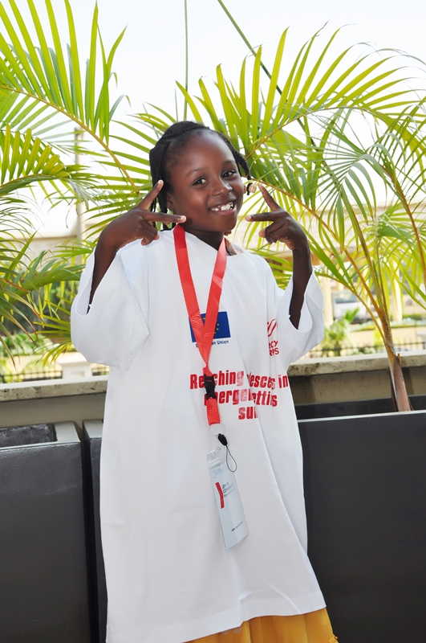

THANK YOU

