Slide 1
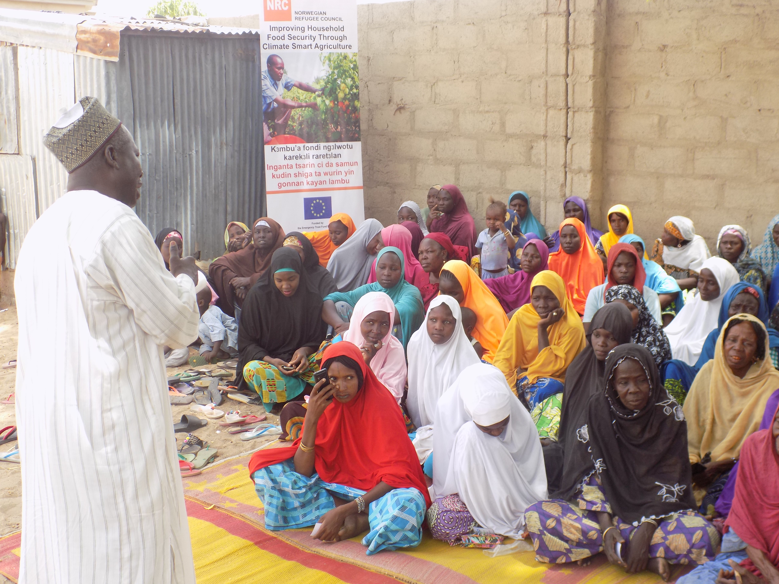
Promoting Resilience and Peaceful Coexistence Among Displaced Affected Communites in Northeast Nigeria
Notes:
Two year grant, 1 November 2016 – 31 December 2018
CCs- LFS and ICLA
Locations – Maiduguri and Jere
Budget - 2,123,000 Euro

Slide 2
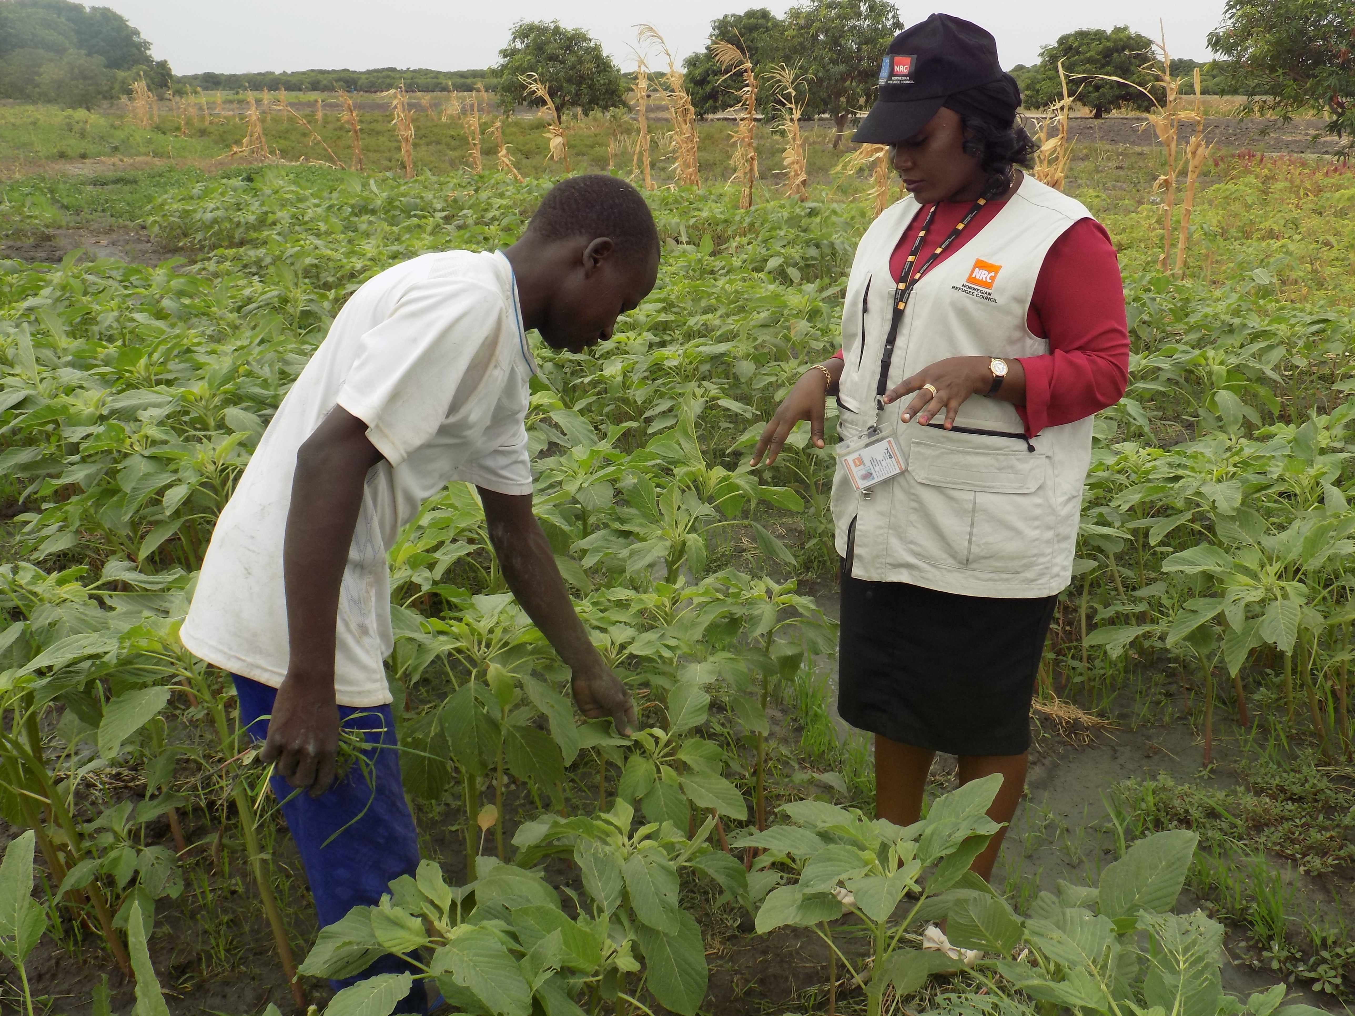
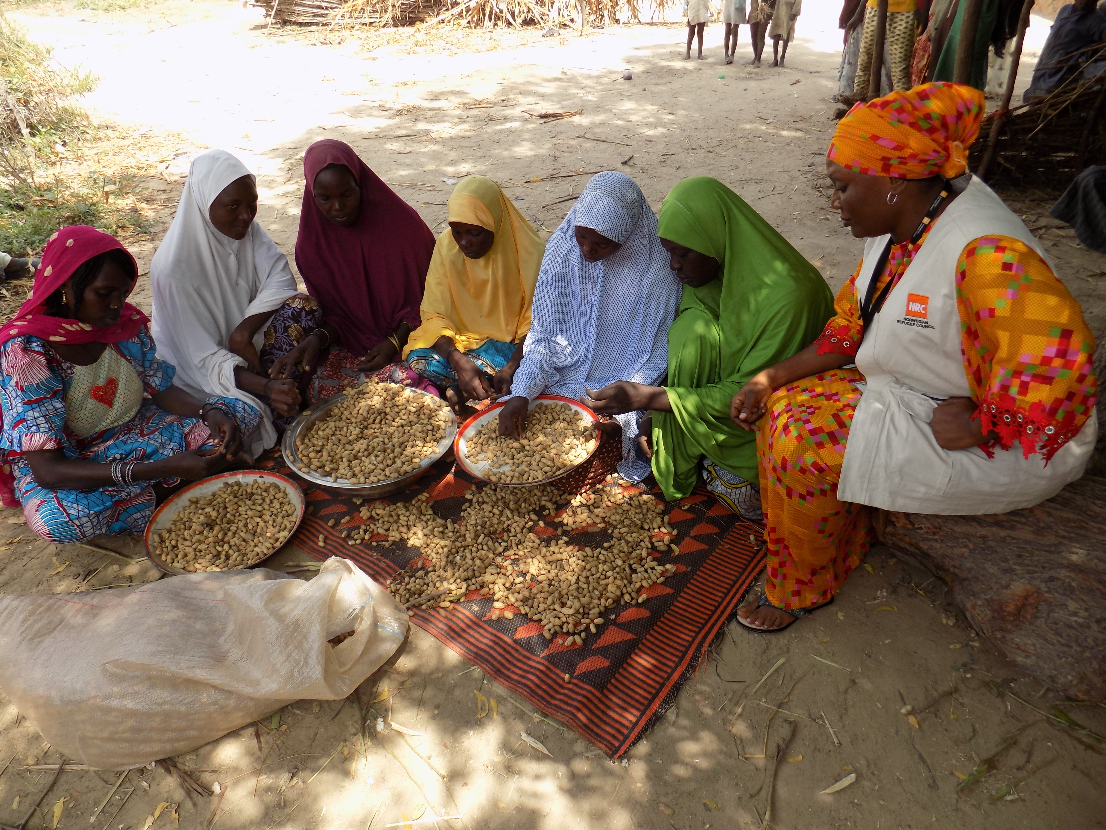
Project activities
Result 1: Livelihoods and Food Security
1,545 households trained in non-food technical skills and provided with an income generating start-up cash grant
1,740 households trained in food production skills and provided with food production inputs
1,741 households trained in Vegetable Crop Production and provided with inputs
Notes:
NRC’s livelihoods and early economic recovery programming responded to urgent needs, stabilised livelihoods, and supported adaptation to living in a protracted crisis. It focused on increasing purchasing power and incomes, as well as increasing food production, for both home consumption and markets.

Slide 3
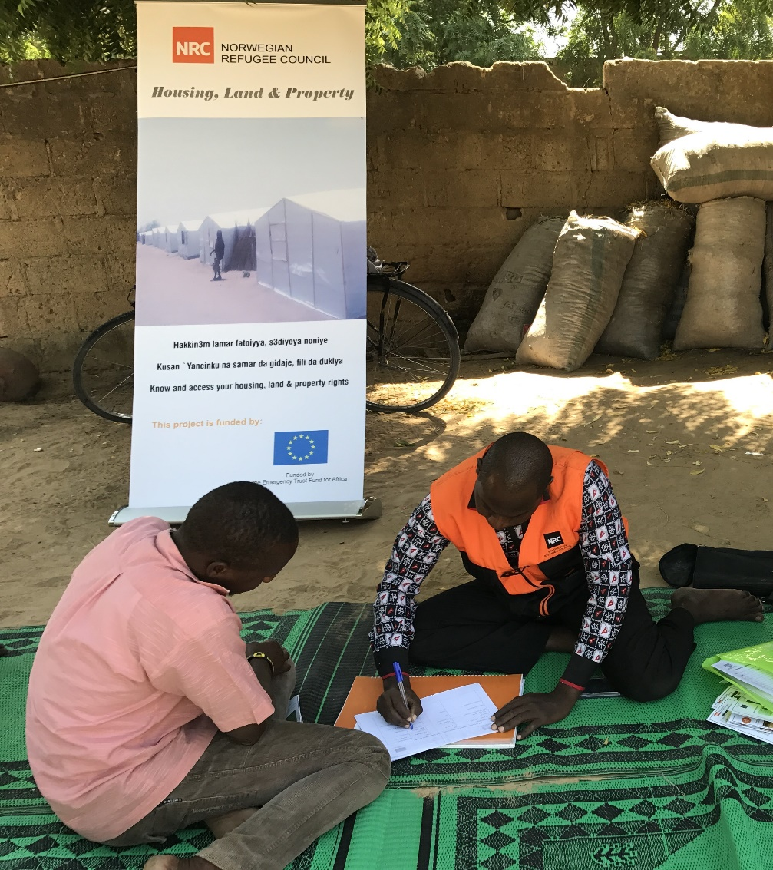
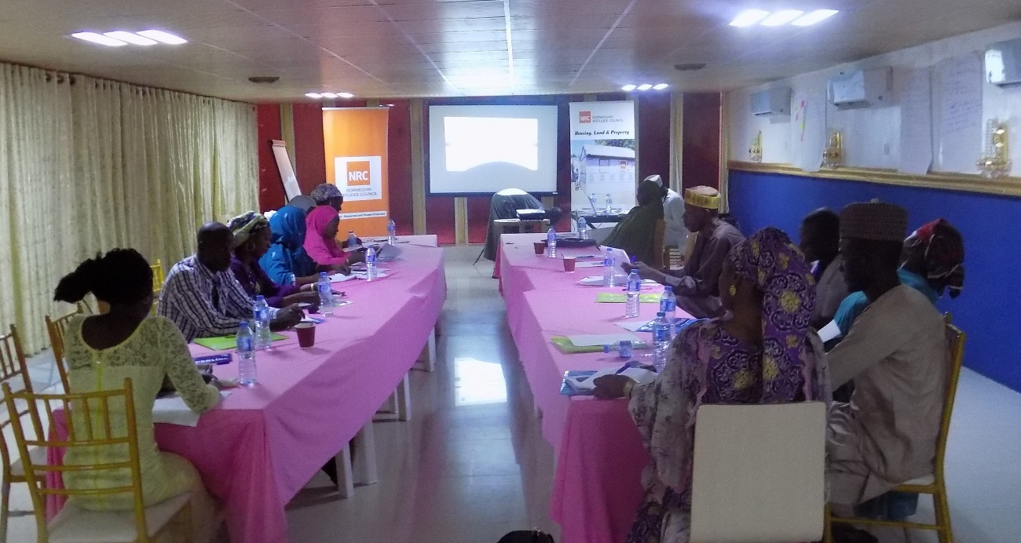
Result 2: Increased capacity to claim and exercise rights
7,089 individuals received information, counselling and legal assistance on HLP rights
1,082 statutory and traditional justice players received training on HLP rights
7,612 individuals received information and counselling on legal identity
Result 3: Strengthen capacity to resolve HLP conflicts peacefully
2,591 statutory and traditional justice players received training on Collaborative Dispute Resolution (CDR)
Notes:
Under result 2, NRC addressed structural barriers to claiming HLP rights together with the provision of information counselling and legal assistance, which improved the security of living conditions. Under result 3, increased the capacity and knowledge of justice players on how to peacefully resolve HLP disputes through collaborative dispute resolutions (CDR), building peaceful coexistence of communities affected by displacement.

Slide 4
Building Resilience
Profit from IGA allows households to meet their basic needs, while capacity building provided beneficiaries with the skills to maintain their business
The project imparted knowledge and skills on good agronomic practices aimed at improving climate adaptability. This include use or compost and organic manure improves water holding capacity of soils and climate adaptability
Ability to produce own food reduces reliance and exposure to volatile food markets in the northeast Nigeria.
Improved security of tenure for beneficiaries as they have a better understanding of their HLP rights
Improved access to services and livelihood opportunities with proper documentation
Justice players capacity has been increased, improving the pace of resolving disputes
Notes:
All three results worked toward building the resilience of IDPs in Maiduguri and Jere:
Result 1 – Improved livelihoods skills, ensure this IDPs are able to meet their own basic food needs and reduce vulnerability to volatile food markets, as well a generate an income from any surplus produce. A specific focus was placed on improving the climate adaptability of IDPs, as the extremes of the climate in Borno State remain a significant challenge to food security. For example, targeted beneficiaries have been able to increase resilience against droughts through improved use of domestic water for irrigating backyard gardens.
Result 2/3 - To restart livelihoods of displaced people, NRC ensured that beneficiaries had access to legal and civil documents and HLP rights, as well as fostered a stable environment for communities, through the training of justice players on CDR.

Slide 5
Lessons Learnt
Planning
Long term monitoring is needed for income generating activities
Flexibility needs to be designed into the food production component
Climate variability needs to be adequately planned for
Mapping of key stakeholders that will receive trainings is necessary
Information sessions and counselling need to be held within safe spaces
Implementation
Use of cash grants allows for livelihoods diversification
Limited capacity of government departments to support agricultural activities
Community structures ease implementation and strengthen acceptance.
When monitor IGAs they are often at the early stage, so need longer timeframe
Knowledge of available land for farming is important in community selection.
Notes:
Planning
Flexibility is necessary to respond to several different challenge. For example , access to land and water needs to be carefully considered as IDPs have limited access. Furthermore, IDPs most used to growing of traditional cereals have limited skills, experience and exposure in growing vegetable crops.
Climate variability especially for rain fed agriculture projects need consideration. Seasonality change such as delayed rain fall have a significant impact on planning of activities by the farmers.
Implementation
It is important to note that the poorest and most vulnerable groups can also benefit from involvement in IGAs.
Due to displacement, the government institutions to assist farmers such as the agriculture extension services has been significantly disrupted to an extend that staff implementing agriculture projects need significant capacity building in order to effectively provide extension services. However, collaboration with government during implementation such as the collaboration with the ministry of Agriculture and Natural resources(MOANR) in delivering capacity building initiatives and trainings is a cost effective and culturally acceptable modality.
Not in the presentation but it is essential that the project teams are flexible and do not impose their own ideas and methods on local people.

Slide 6
Sustainability
Cash grants allowed beneficiaries to have multiple IGAs, reducing risk of shocks.
Engaging local CBOs and government to provide opportunity of ongoing project support
Beneficiaries were introduced to financial markets through cash grants
Retention of seeds for future use, through development of seed banks
Increased productivity of limited resources, such as land and water
Reduced need for expensive fertilisers, through use of organic manure
Vulnerable groups were facilitated to end the marketplace and generate income
Surplus income was used by beneficiaries to purchase assets to improve production
Food security improved at the household level
Diversification of diets
Notes:
Additionally, collaboration with Housing, Land and Property (HLP) facilitated access to land for agricultural purposes as a result of trainings conducted by ICLA on HLP

Slide 7
Challenges
No financial service providers in the LGAs
Security continues to impact implementation outside of Maiduguri
Limitation on access to land
Limited surface water sources
Transportation of liquid fertiliser can take significant amount of time
Limited use of appropriate technology due to resource constraints.
Limited capacity from government institutions particularly agriculture extension services

Slide 8
Implementation of early recovery activities in a protracted crisis in the northeast Nigeria is constrained by the following:
Continued influx of IDPs disrupting already established livelihoods activities of targeted households
Displacements limit the extent and scale of investment in livelihood infrastructure, such as irrigation.
Key gaps in IDP return intentions complicate planning of activities
Security restrictions limit movement of project inputs, such as cash grants and fertilisers
Unwillingness of government stakeholders to operate in hard to reach areas
Notes:
However, although there were constraints, NRC found that the resilience of beneficiaries has been developed, so that they can better meet their basic needs and improve their livelihoods. The crisis is ongoing in northeast Nigeria, with no indication that it will improve in 2019, indicating that there is a need in the more stable areas, for example Maiduguri and Jere, to help displaced people develop their skills and build the livelihood opportunities.

