Slide 1
Project Update, Lesson Learnt, Successes and Challenges.
Duration: 01/12/2016 – 31/12/2018 (24 months) extended to March 2019
Geographical Scope: Northeast Nigeria, Adamawa and Borno States
‘Project Title: “Promoting Stability in Nigeria's Northeast”

Slide 2
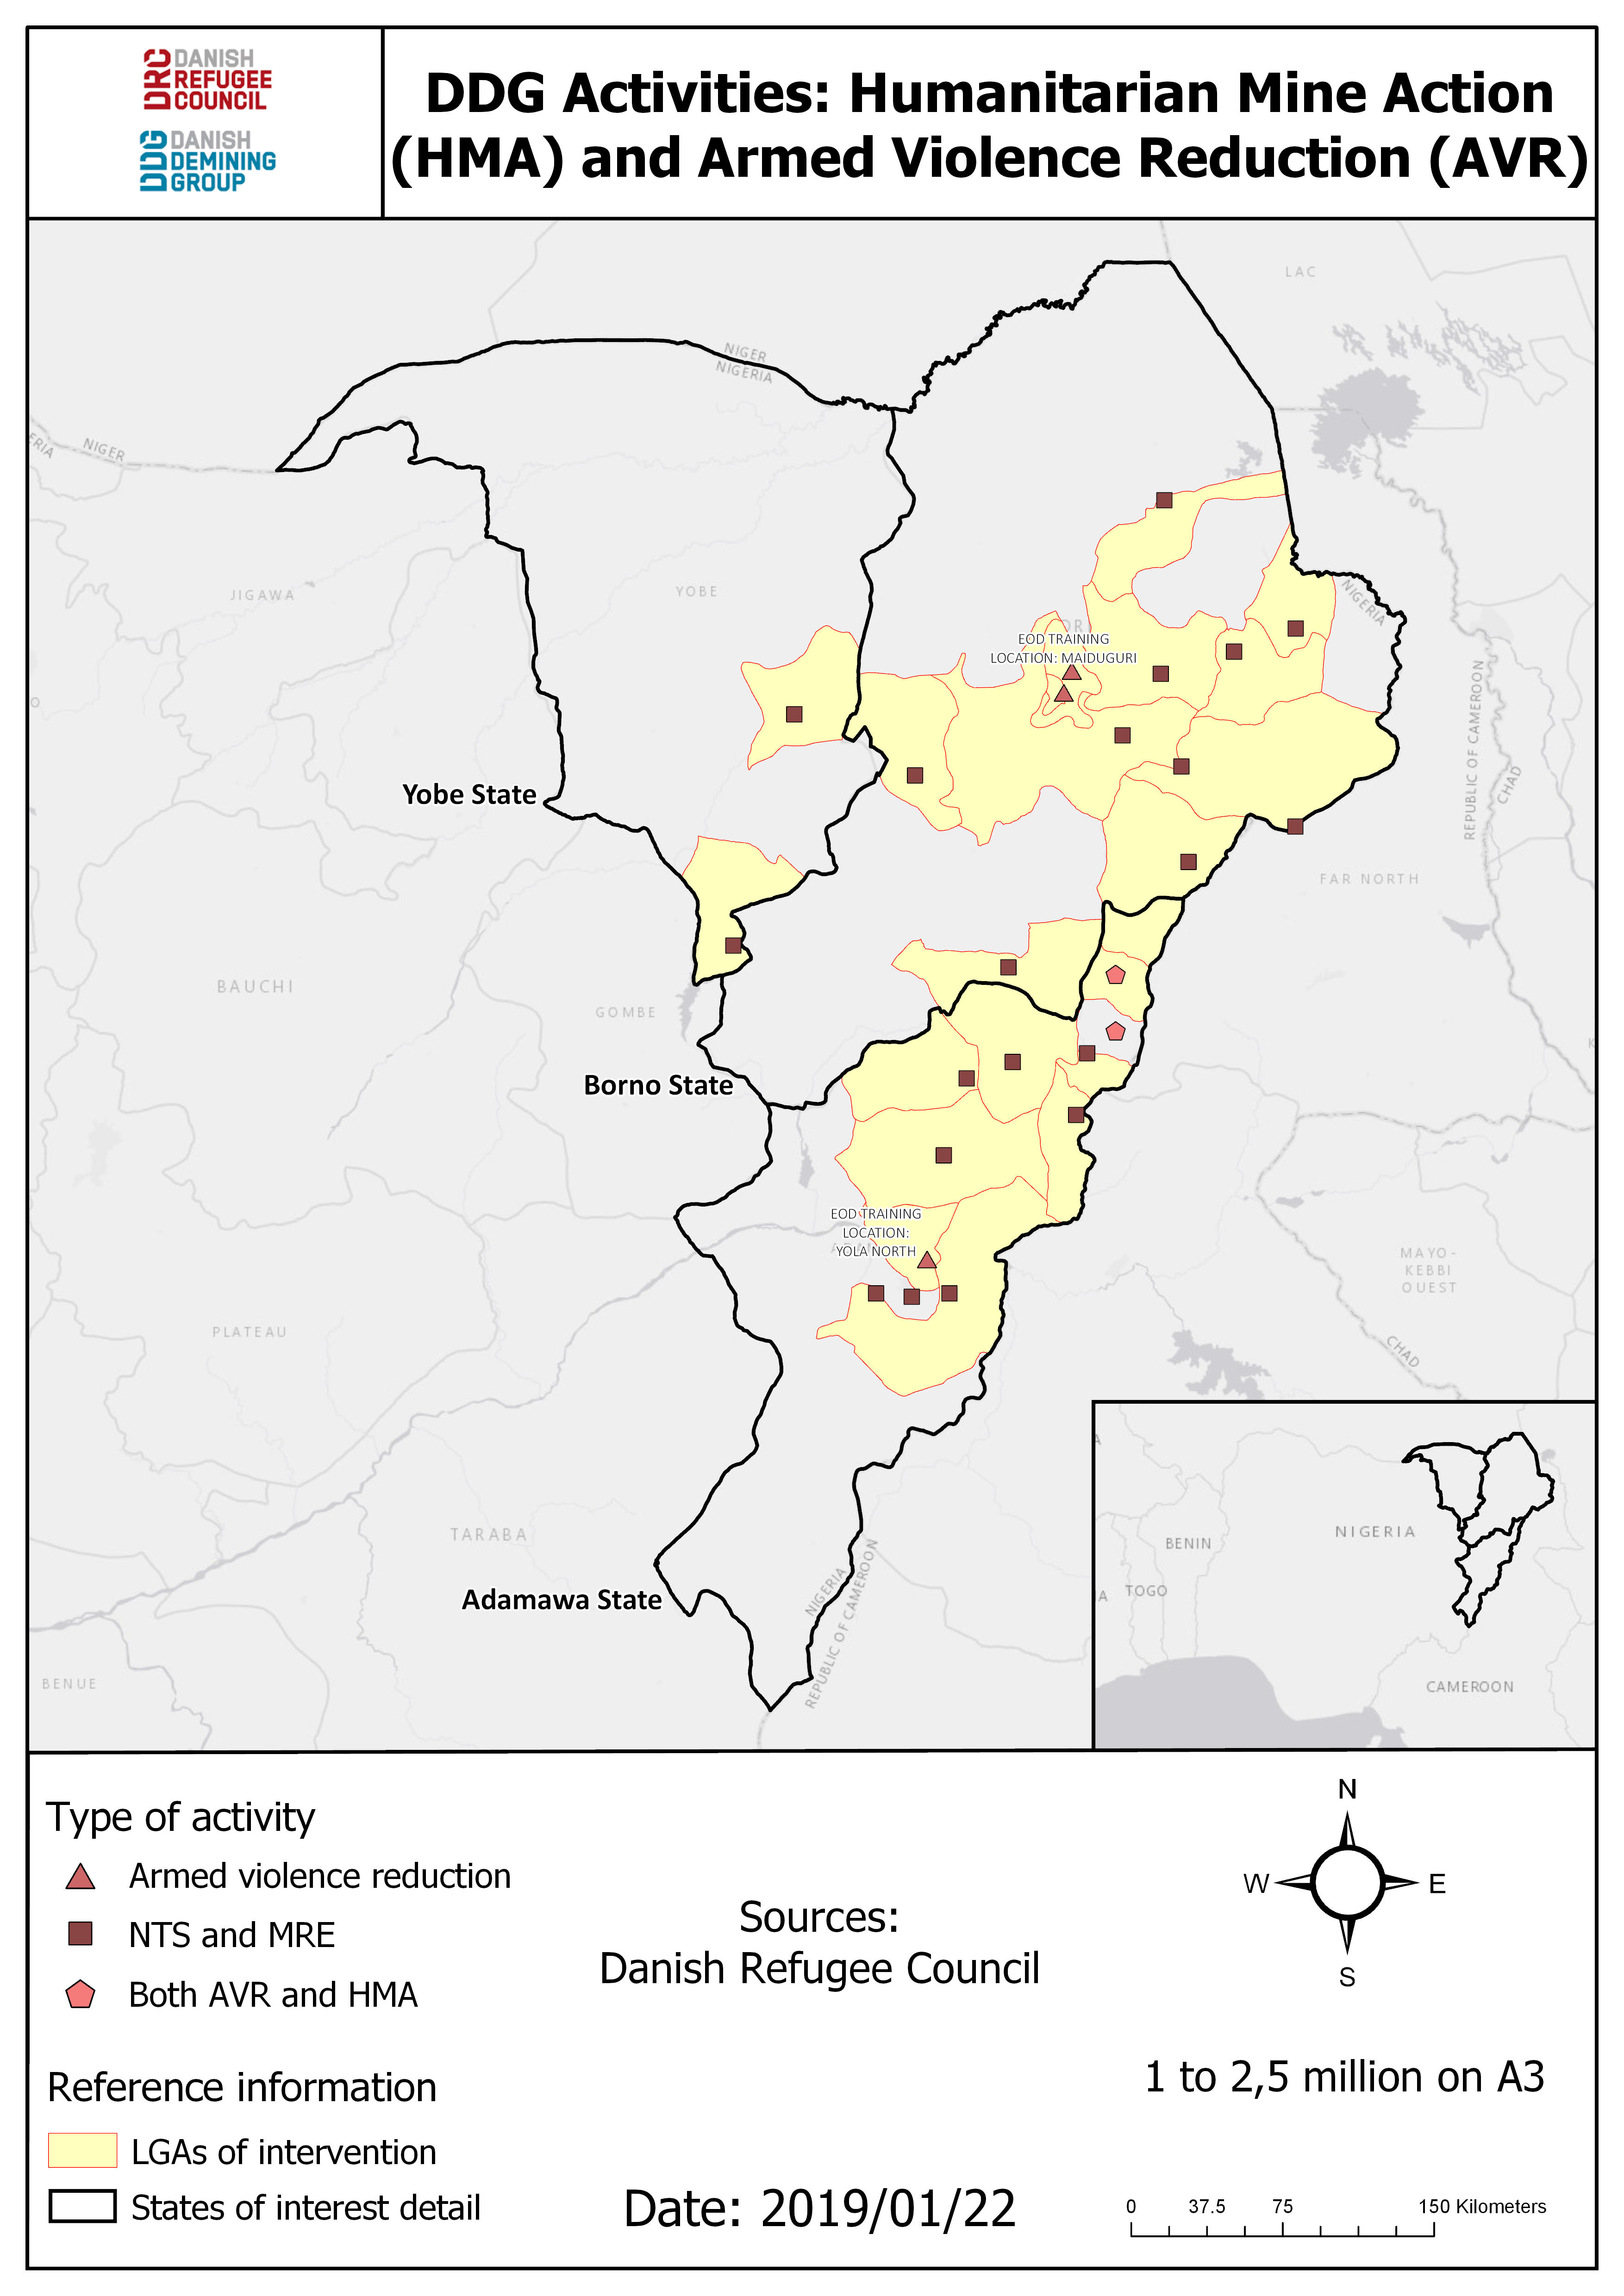

Slide 3
Project Components
1. Armed Violence Reduction (AVR)
  Livelihood Youth Engagement
  Dialogue Engagement
  Community Safety
  Conflict Management
2. Livelihood
  Small Home Gardening Assistance Packages
  Entrepreneurship Training Workshops and Small Grants
  Multi-purpose Cash Grants for Extremely Vulnerable Individuals
  Cash for Work for Youth
  Trade-specific Training Workshops

Slide 4
Project Objectives
    Obj.1. To improve community resilience and socio-economic recovery of 4,100 people by providing support to IDPs and host communities to better meet their basic needs and cope with future shocks (Livelihood).
Obj.2. To empower at risk youth by strengthening young IDPs' skills and preference for peaceful and constructive behaviour, resilience to negative influences and providing access to alternative, legitimate livelihood opportunities (AVR).
Obj.3. To enhance community safety and conflict mediation capacities by developing IDP and host communities abilities to implement their own community safety plans and to call on a network of community-based conflict mediators to resolve disputes peacefully (AVR).

Slide 5
Breakdown of Targets and Achievements (Livelihood)
Activities | Target | Achieved
R1.A1. Socio-economic livelihoods assessment report (Livelihoods Market Assessment, Baseline) -Consultant | 1 | 1 Livelihood Market Assessment Conducted focusing on SME, VST and CTDM
R1.A2. Small home gardening assistance packages provided and small poultry distributed to women -Work with Ministry of Agriculture and local trainers | 450 | 450 Women support with agricultural production trainings and kits (390 gardening and 60 poultry)
R1.A3. Entrepreneurship training workshops and small grants provided to vulnerable women -Market Assessment to inform programming | 200 women for training workshops and 75 vulnerable women to receive small grants | 250 Women trained on business management 249 Women received business grants
R1.A4. Multi-purpose cash grants provided to EVIs (conditional or unconditional) -Vulnerability mapping with Protection | 150 Extremely vulnerable individuals (EVIs) | 304 EVI supported for 4 months ( 1 month remaining)
R1.A5. Cash for Work provided to youth -Work with AVR to profile youth | 175 Youth | 187 Youth provided with CFW for 5 months (1 month remaining)
R2. Trade-specific training workshops organised for youth. Business start up kits | 50 Youth | 150 Youth trained on business management 141 Youth received business grants CFW supported the creation of 6 Youth Safe Spaces

Slide 6
Breakdown of Targets and Achievements (AVR)
S/n | Thematic Components | Activities | Project Target | Achieved
1. | Youth Engagement | YES! Framework- Youth Empowerment and Safety (YES!) planning process | 18 YES! Plans | 18 YES! plans
 |  | Implementation of youth recreational activities to enhance social cohesion | 36 | 41
 |  | Infrastructure development and support-construction of Youth Safe Spaces/Centers | 6 | 6
 |  | Training on youth leadership and communication | 720 | 724
2. | Dialogue Engagement | Training on Inter-generational Dialogue and Inter-Faith Dialogue process | 375 | 3107
 |  | Community-Police (Security Providers) Dialogue and Cooperation (CPDC) workshops | 18 Declarations | 18 Declarations
3. | Community Safety | Community Safety Planning process and the development and implementation of community safety action plans | 18 CS-Plans | 18 CS-plans
4. | Conflict Management | Trainings – Youth (Community leaders, CSOs/FBOs, Government Security Providers, DRC’s staff) | 720 | 1062
 |  | Direct efforts at Mediation and (peace-process) dialogue | 288 | 363

Slide 7
Program Challenges – Livelihood
Challenges Experienced | Solutions
Poor market for poultry | DRC engaged beneficiaries and the Ministry of Livestock Production to see how the program could diversify agricultural production and improve sales. Through market assessment and analysis by the Ministry of Livestock Production, eggs showed to be in higher demand in the local markets compared to whole chickens. As a result, the program shifted from meat production to egg production.
Operation and maintenance of water pumps was difficult | DRC staff continually ensured that water pumps were properly fuelled and repaired. In future projects, DRC will include some men in the program to support with the operation and maintenance of water pumps and the heavy manual labour required at the garden sites.
Theft of fencing materials | DRC engaged the beneficiaries and local leadership through discussions to ensure security of infrastructure and materials at the garden site to avoid theft and damage.
Some men complained of being excluded | DRC explained to communities the purpose women only activities, and their importance in empowering vulnerable women through providing livelihood opportunities.

Slide 8
Program Challenges - AVR
Challenges Experienced | Solutions
Difficult process of acceptance due to large software programming | Persistent advocacy and sensitisation of resilience-building impact Minimal support for outcomes
Limited participation of women due to cultural and religious beliefs | Strong advocacy Gender separation at programme outset
Programme implementation conflicted with planting/harvest season and different religious holidays | Intense advocacy with target groups for buy-in Consultative spread-out of programme timing
Poor weather conditions – excessive heat | Adapted activities with limited hours for sessions
Transportation - sometimes vehicle options unsuitable for terrain | Scheduled and coordinated activities with vehicle options

Slide 9
Program Achievements - Livelihood
450 women supported with agricultural production training and kits.
250 women trained on business management.
249 women received business grants.
304 extremely vulnerable individuals supported with cash grants for 4 months.
187 Youth provided with Cash for Work for 5 months.
150 youth trained on business management.
141 youth received business grants.

Slide 10
Program Achievements - AVR
Training of 44 civil society organizations on conflict management and dialogue facilitation techniques has contributed to resolving some of the herder-farmer conflicts in Adamawa state.
There is increased demand for the capacity development of youth on peacebuilding and establishment of peace-clubs in schools.
There is growing awareness on the importance of community-focused policing (thereby contributing to security sector reform).
There are improved levels of trust-based relationships between government security providers and community members e.g., the establishment of a communication network to share security-related information.
An improved sense of collaboration, acceptance and joint sense of responsibility between members of local safety organizations and hunter groups.

Slide 11
Lessons Learnt
Engaging government ministries in program development provides an opportunity to maximize resources and provides additional validation of the program’s legitimacy and potential to beneficiaries.
Programming needs to allow for beneficiary feedback and beneficiary-led modifications as much as possible. This was highlighted in beneficiaries wanting to move from poultry to egg production and the program being flexible enough to facilitate this.
Ensuring participation from groups including at-risk youth, women and the elderly requires community level advocacy measures throughout the life of the project – not just in the planning stages.

Slide 12
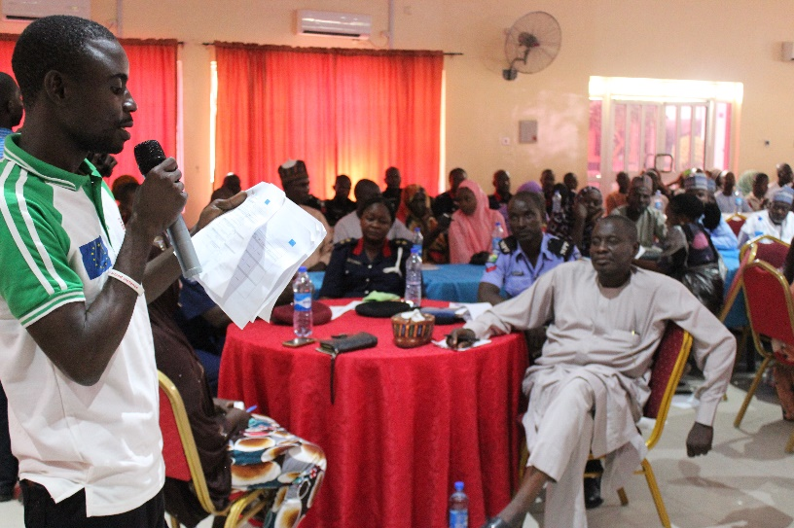
Thank You!
Youth presenting Community Safety Action Plans at state level during CSP workshop in Auno Community, Maiduguri LGA, Borno State.

